Slide 1

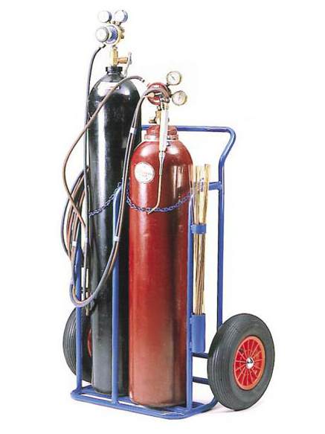


FC-GL-EHS-SAF-0716: Compressed Gas
Design & Construction
Scope / Key Changes
First Issue Replaces and supersedes: FC-GL-EHS-SAF-003A: Compressed Gas Simpler more streamlined approach: Guidance type content moved to Appendices Improved Manual Handling guidance More focus on International design standards
Return to Supplier
Ordering & Receipt
Operation & Use
Inspection
Key Tools
Appendices: A - International Standards for Compressed Gas Equipment B - Additional Design and Risk Assessment Considerations C – Manual Handling Guidance
Transport & Handling
Storage
Further Work / Support
No significant change in content
Training
V1 / Mar 2021

